Slide 1

The Conscience of the world
What the hibakusha ask from us
75 years after Hiroshima

Slide 2
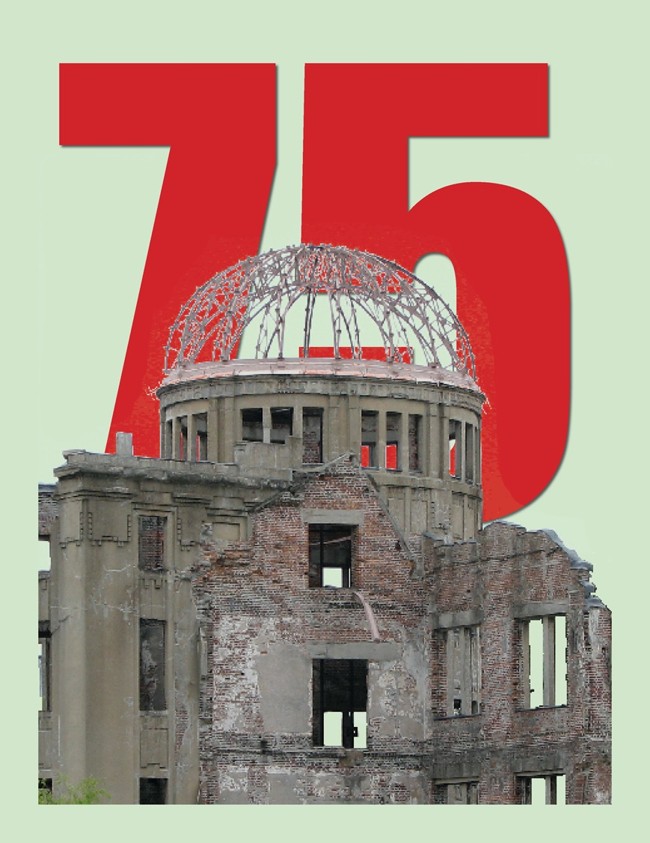
The Conscience of the world
What the hibakusha ask from us
75 years after Hiroshima

Slide 3
Setsuko Thurlow at the United Nations

Slide 4
BACK IN THE GAME
“The President has chosen to put the US
back into the nuclear game.”
~ Dan Brouillette
Secretary of Energy
July 2020

Slide 5
BACK IN THE GAME
“The President has chosen to put the US
back into the nuclear game.”
25% increase in FY 2021 Budget for Nuclear Weapons

Slide 6
BACK IN THE GAME
“The President has chosen to put the US
back into the nuclear game.”
UPF Bomb Plant in Oak Ridge
Plutonium Pit Bomb Plants
• Savannah River and Los Alamos

Slide 7
BACK IN THE GAME
The “Game” is the new global nuclear arms race. At a cost of more than $2 Trillion. For new bombs, new bomb plants, new jets and submarines—new everything.
The “Game” has no winners. The “Game” is the end of life on the planet.

Slide 8
The bomb at 75
“I hope I can impart how it contributed to the betterment of humanity.”
~ Lisa Gordon-Hagerty
National Nuclear Security Administration
July 2020, Remembering the Trinity test

Slide 9
GAME CHANGER: The treaty on the prohibition of nuclear weapons
signature states
ratification/accessions
Needed: 50
To date: 83
Needed: 50
To date: 44

Slide 10
The treaty on the prohibition of nuclear weapons
signature states
ratification/accessions
Needed: 50
To date: 83
Needed: 50
To date: 44
Aug 6 & 9 : Ireland, Nigeria, Niue, St. Kitts and Nevis
Today: Mozambique becomes latest signatory!

Slide 11
The treaty on the prohibition of nuclear weapons
Deeply concerned about the catastrophic humanitarian consequences that would result from any use of nuclear weapons, and recognizing the consequent need to eliminate such weapons, which remains the only way to guarantee that nuclear weapons are never used again under any circumstances,
Mindful of the risks posed by the continued existence of nuclear weapons including from any nuclear-weapon detonation by accident, miscalculation or design, and emphasizing that these risks concern the security of all humanity…

Slide 12
The treaty on the prohibition of nuclear weapons
Cognizant that the catastrophic consequences of nuclear weapons cannot be adequately addressed, transcend national borders, pose grave implications for human survival, the environment, socioeconomic development, the global economy, food security, and the health of current and future generations…
Acknowledging the ethical imperatives for nuclear disarmament and the urgency of achieving and maintaining a nuclear-weapon-free world, which is a global public good of the highest order…

Slide 13
The treaty on the prohibition of nuclear weapons
Each state party undertakes never under any circumstances to:
(a) develop, test, produce, manufacture, otherwise acquire, possess of stockpile nuclear weapons or other nuclear explosive devices;
(b) transfer to any recipient whatsoever nuclear weapons or other nuclear explosive devices or control over such weapons directly or indirectly;
(d) use or threaten to use nuclear weapons or other nuclear explosive devices;
(g) allow any stationing, installation or deployment of any nuclear weapons in its territory or at any place under its jurisdiction or control.

Slide 14
The treaty on the prohibition of nuclear weapons
Will only apply to State Parties
Will increase pressure on NATO countries that host US nuclear weapons to remove them
Will increase pressure on “nuclear umbrella” states to renounce nuclear defense
Will eventually isolate nuclear weapons states and identify them as “international outlaws”

Slide 15
The treaty on the prohibition of nuclear weapons
Incorporates the language used by the hibakusha in calling for the elimination of nuclear weapons as the only way to guarantee they are never again used.

Slide 16

The HIBAKUSHA APPEAL
“Earnestly desiring the elimination of nuclear weapons without delay, we, the hibakusha, call on all state governments to conclude a treaty to ban and eliminate nuclear weapons.”

Slide 17
The HIBAKUSHA APPEAL
“Earnestly desiring the elimination of nuclear weapons without delay, we, the hibakusha, call on all state governments to conclude a treaty to ban and eliminate nuclear weapons.”
hibakusha-appeal.net/english/

Slide 18
Lesson from the pandemic
We cannot afford to be complacent about high consequence events, even if we believe they are low probability.

Slide 19
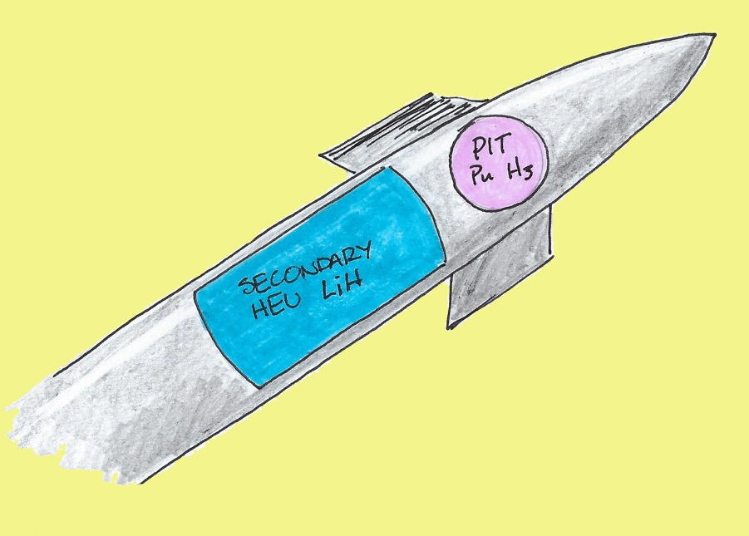
BACK IN THE GAME =
The NEW NUCLEAR ARMS RACE
UPF Bomb Plant in Oak Ridge
Plutonium Pit bomb plants at
Los Alamos and Savannah River
New design warheads (W87-1 and W93)
80 WARHEADS / YEAR

Slide 20
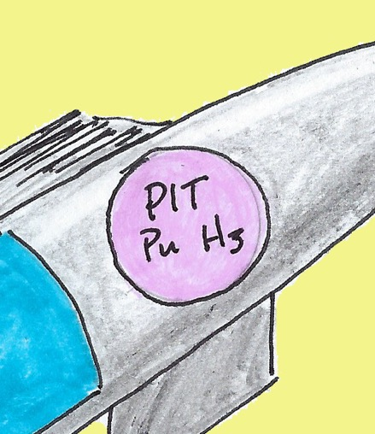
PlutoNIUM PIT: The Primary/Trigger
80 pits/year by 2030
los alamos — expand capacity to 30/year
savannah river — new mission (repurpose MOX plant) produce up to 50 pits/year
environmental studies underway—awaiting NNSA decisions
Efforts to increase money in budget
15,000+ pits in storage at pantex
New pits for new bombs

Slide 21
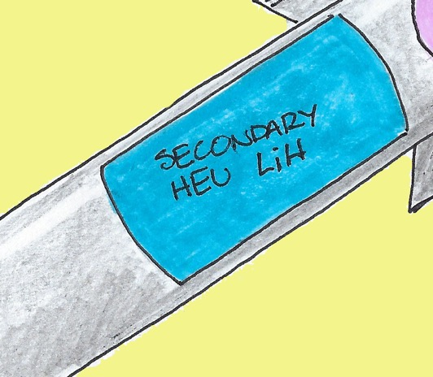
Secondary: Canned Subassembly
MANUFACTURED AT Y-12 IN OAK RIDGE
HIGHLY ENRICHED URANIUM, LITHIUM DEUTERIDE AND DEPLETED URANIUM
THERMONUCLEAR
PRODUCED IN FACILITIES THAT DO NOT MEET CURRENT ENVIRONMENTAL AND SEISMIC STANDARDS

Slide 22
UPF Bomb Plant in Oak RidGE - $6 Billion +
under construction
lawsuit win in 2019 — nnsa continues construction
enforcement order filed — awaiting court action
new supplemental analysis released — record of decision pending
new legal challenge ?

Slide 23
What you can do
sign the hibakusha appeal
support OREPA’s legal challenge and work
contact senators and reps now re: the budget
VOTE
write a letter to the editor or an op-ed

Slide 24
The most important thing we can do
The single most important thing we can do right now is to build broad opposition to the new nuclear arms race. To do that, we have to make people aware that it is happening, and remind them of the danger of complacency when the danger is so great.

Slide 25
Start where people are already organized
Veterans for Peace
Churches, Mosques, Temples, Synagogues
League of Women Voters, Sierra Club, etc.
Book clubs, social groups
Progressive allies (DSA, BLM, NPJC, and others…)

Slide 26
Setsuko Thurlow • August 6, 2020

Slide 27
What the hibakusha ask of us
“We made the bomb. We can get rid of it.
We have that kind of power.”
~ Setsuko Thurlow

Slide 28
QUESTIONS?

Slide 29
Oak ridge environmental peace alliance
www.orepa.org

